Slide 1




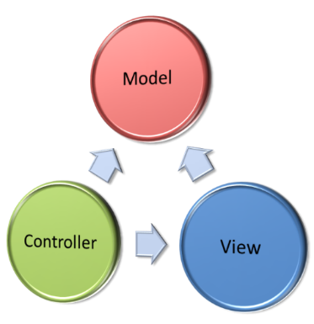

Web Security
SQL Injection, XSS, CSRF, Parameter Tampering, DoS Attacks, Session Hijacking
SoftUni Team
Technical Trainers
Software University
http://softuni.bg

Slide 2


Table of Contents
Web Security Main Concepts
Main Security Problems with Examples
SQL Injection
Cross Site Scripting (XSS)
Cross-Site Request Forgery (CSRF)
Parameter Tampering
Other Threats

Slide 3

Web Security Main Concepts

Slide 4
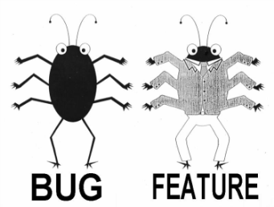
Feature or Bug
Is Software Security a Feature?
Most people consider software security as a necessary feature of a product
Is Security Vulnerability a Bug?
If the software "failed" and allowed a hacker to see personal info, most users would consider that a software bug
Notes:
Advanced Software Testing Vol. 1

Slide 5

Reasons for Failures
Software failures usually happen spontaneously
Without intentional mischief
Failures can be result of malicious attacks
For the Challenge/Prestige
Curiosity driven
Aiming to use resources
Vandalizing
Stealing
Notes:
Software Security Testing, Gary McGraw
+
Software Testing, Ron Patton

Slide 6


Golden Rules!
Maximum Simplicity
More complicated – greater chance for mistakes
Secure the Weakest Link
Hackers attack where the weakest link is
Limit the Publicly Available Resources
Incorrect Until Proven Correct
Consider each user input as incorrect
The Principle of the "Weakest Privilege"
Security in Errors (Remain stable)
Provide Constant Defense (also use backups)

Slide 7

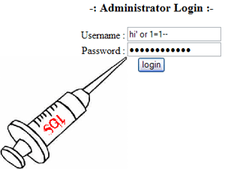

SQL Injection
What is SQL Injection and How to Prevent It?

Slide 8
What is SQL Injection?
Try the following queries:
' → crashes
'; INSERT INTO Messages(MessageText, MessageDate) VALUES ('Hacked!!!', '1.1.1980') → injects a message
protected void ButtonSearch_Click(object sender, EventArgs e)
{
string searchString = this.TextBoxSearch.Text;
string searchSql = "SELECT * FROM Messages WHERE MessageText LIKE '%" + searchString + "%'";
MessagesDbContext dbContext = new MessagesDbContext();
var matchingMessages =
dbContext.Database.SqlQuery<Message>(searchSql).ToList();
this.ListViewMessages.DataSource = matchingMessages;
this.DataBind();
}

Slide 9
How Does SQL Injection Work?
The following SQL commands are executed:
Usual search (no SQL injection):
SQL-injected search (matches all records):
SQL-injected INSERT command:
SELECT * FROM Messages WHERE MessageText LIKE '%nakov%'"
SELECT * FROM Messages WHERE MessageText LIKE '%%%%'"
SELECT * FROM Messages WHERE MessageText LIKE '%' or 1=1 --%'"
SELECT * FROM Messages WHERE MessageText
LIKE '%'; INSERT INTO Messages(MessageText, MessageDate) VALUES ('Hacked!!!', '1.1.1980') --%'"

Slide 10
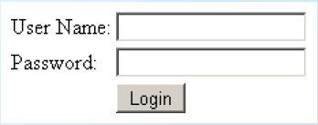
Another SQL Injection Example
Original SQL Query:
Setting username to John & password to ' OR '1'= '1 produces
The result:
If a user Admin exists – he is logged in without password
String sqlQuery = "SELECT * FROM user WHERE name = '" + username + "' AND pass='" + password + "'"
String sqlQuery = SELECT * FROM user WHERE name = 'Admin' AND pass='' OR '1'='1'

Slide 11
Preventing SQL Injection
Ways to prevent the SQL injection:
SQL-escape all data coming from the user:
Not recommended: use as last resort only!
Preferred approach:
Use ORM (e.g. Entity Framework)
Use parameterized queries
string searchSql = @"SELECT * FROM Messages
WHERE MessageText LIKE {0} ESCAPE '~'";
string searchString = "%" +
TextBoxSearch.Text.Replace("~", "~~").Replace("%", "~%") + "%";
MessagesDbContext dbContext = new MessagesDbContext();
var matchingMessages = dbContext.Database.SqlQuery<Message>(searchSql, searchString);

Slide 12
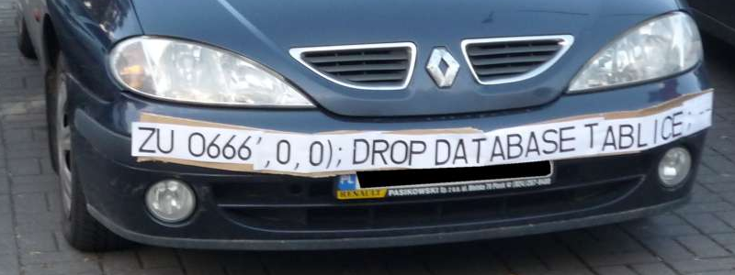
SQL Injection and Prevention
Live Demo

Slide 13
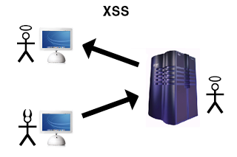
Cross Site Scripting (XSS)
<script>…
<script>…
What is XSS and How to Prevent It?

Slide 14
XSS Attack
Cross-site scripting (XSS) is a common security vulnerability in Web applications
Web application is let to display a JavaScript code that is executed at the client's browser
Crackers could take control over sessions, cookies, passwords, and other private data
How to prevent from XSS?
Validate the user input (built-in in ASP.NET)
Perform HTML escaping when displaying text data in a Web control

Slide 15


XSS
Cross-site scripting attack
Cookie theft
Account hijacking
Modify content
Modify user settings
Download malware
Submit CRSF attack
Password prompt
Execute the script on visiting the page
Submits script on an unsafe form

Slide 16
Automatic Request Validation
ASP.NET applies automatic request validation
Controlled by the ValidateRequest attribute of Page directive
Checks all input data against a hard-coded list of potentially dangerous values
The default is true
Using it could harm the normal work on most applications
E.g. a user posts JavaScript code in a forum
Escaping is a better way to handle the problem
500 Internal Server Error: A potentially dangerous Request.Form value was detected from the client (…)

Slide 17
Disable Request Validation
ASP.NET WebForms
Disable the HTTP request validation for all pages in Web.config (in <system.web>):
ASP.NET MVC
Using the ValidateInput filter we can disable validation for an action or entire controller
<httpRuntime requestValidationMode="2.0" />
<pages validateRequest="false" />
[ValidateInput(false)]
public ActionResult XssMvc(string someInput) { … }

Slide 18

What is HTML Escaping?
HTML escaping is the act of replacing special characters with their HTML entities
Escaped characters are interpreted as character data instead of mark up
Typical characters to escape
<, > – start / end of HTML tag
& – start of character entity reference
', " – text in single / double quotes
…

Slide 19
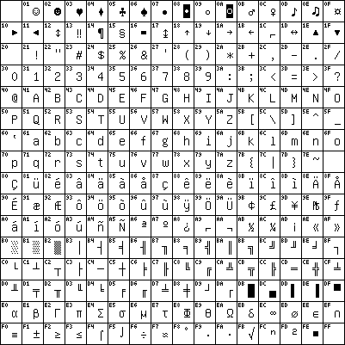
HTML Character Escaping
Each character could be presented as HTML entity escaping sequence
Numeric character references:
'λ' is &#955;, &#x03BB; or &#X03bb;
Named HTML entities:
'λ' is &lambda;
'<' is &lt;
'>' is &gt;
'&' is &amp;
" (double quote) is &quot;

Slide 20
How to Encode HTML Entities?
HttpServerUtility.HtmlEncode
HTML encodes a string and returns the encoded (html-safe) string
Example (in ASPX):
HTML Output:
Web browser renders the following:
<%: "The image tag: <img>" %>
<%response.write(Server.HtmlEncode("The image tag: <img>"))%>
The image tag: &lt;img&gt;
The image tag: <img>

Slide 21
Preventing XSS in ASP.NET MVC
The Razor template engine in ASP.NET MVC escapes everything by default:
To render un-escaped HTML in MVC view use:
@{ ViewBag.SomeText = "<script>alert('hi')</script>"; }
@ViewBag.SomeText
&lt;script&gt;alert(&#39;hi&#39;)&lt;/script&gt;
@{ ViewBag.SomeText = "<script>alert('hi')</script>"; }
@Html.Raw(ViewBag.SomeText)
<script>alert('hi')</script>

Slide 22
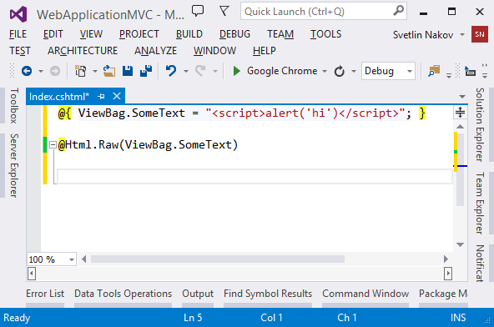
HTML Escaping in Web Forms and MVC Apps
Live Demo
Notes:
*
03-May-1507/16/96
(c) 2005 National Academy for Software Development - http://academy.devbg.org. All rights reserved. Unauthorized copying or re-distribution is strictly prohibited.*
22##

Slide 23

Cross-Site Request Forgery
What is CSRF and How to Prevent It?

Slide 24
What is CSRF?
Cross-Site Request Forgery (CSRF / XSRF) is a web security attack over the HTTP protocol
Allows executing unauthorized commands on behalf of some authenticated user
E.g. to transfer some money in a bank system
The user has valid permissions to execute the requested command
The attacker uses these permissions to send a forged HTTP request unbeknownst to the user
Through a link / site / web form that the user is allured to open

Slide 25
CSRF Explained
How does CSRF work?
The user has a valid authentication cookie for the site victim.org (remembered in the browser)
The attacker asks the user to visit some evil site, e.g. http://evilsite.com
The evil site sends HTTP GET / POST to victim.org and does something evil
Through a JavaScript AJAX request
Using the browser's authentication cookie
The victim.org performs the unauthorized command on behalf of the authenticated user

Slide 26
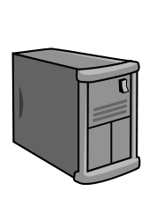
CSRF
Cross-site request forgery attack
Evil.com
<form action=“mysite.com/ChangePassword”>
MySite.com
Authentication cookie
Login
Submit data on behalf of User
User

Slide 27
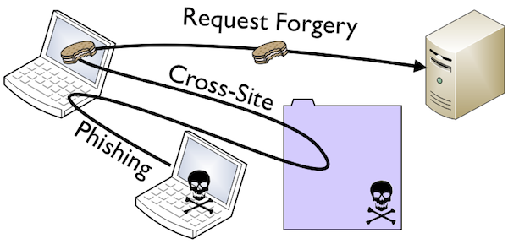
Cross-Site Request Forgery
Live Demo

Slide 28
Prevent CSRF in ASP.NET MVC
To prevent CSRF attacks in MVC apps use anti-forgery tokens
Put the anti-CSRF token in the HTML forms:
Verify the anti-CSRF token in each controller action that should be protected:
@using (@Html.BeginForm("Action", "Controller"))
{
…
@Html.AntiForgeryToken()
}
[ValidateAntiForgeryToken]
public ActionResult Action(…)
{ … }

Slide 29
Prevent CSRF in AJAX Requests
In jQuery AJAX requests use code like this:
Send the token in the AJAX requests:
<%-- used for ajax in AddAntiForgeryToken() --%>
<form id="__AjaxAntiForgeryForm" action="#"
method="post"><%= Html.AntiForgeryToken()%></form>
$.ajax({
type: "post",
dataType: "html",
url: …,
data: AddAntiForgeryToken({ some-data })
});

Slide 30
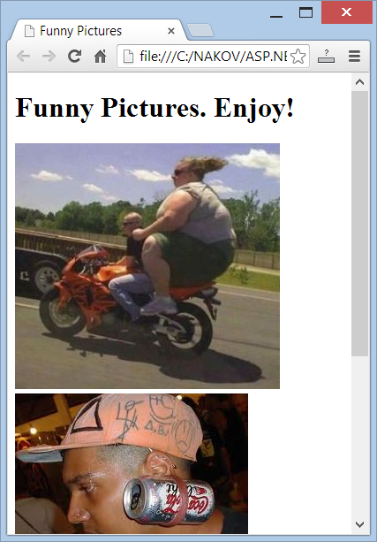
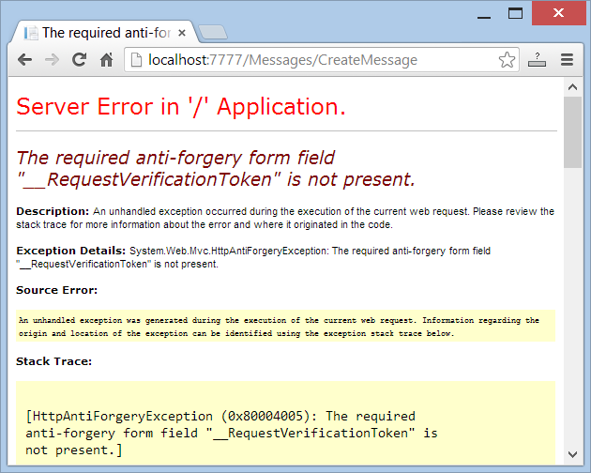
Anti-CSRF in MVC Apps
Live Demo

Slide 31
Prevent CSRF in Web Forms
In Web Forms just add the following code in your Site.Master.cs:
It changes the VIEWSTATE encryption key for all pages when there is a logged-in user
In the VS 2013 Web Forms app template, there is already CSRF protection in Site.master.cs
protected override void OnInit(EventArgs e) {
base.OnInit(e);
if (Page.User.Identity.IsAuthenticated)
{
Page.ViewStateUserKey = Session.SessionID;
}
}

Slide 32
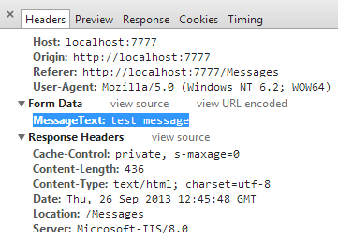
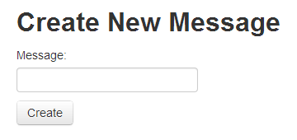
Parameter Tampering
What is Parameter Tampering and How to Prevent It?

Slide 33
What is Parameter Tampering?
What is Parameter Tampering?
Malicious user alters the HTTP request parameters in unexpected way
Altered query string (in GET requests)
Altered request body (form fields in POST requests)
Altered cookies (e.g. authentication cookie)
Skipped data validation at the client-side
Injected parameter in MVC apps

Slide 34
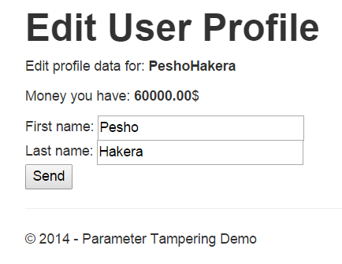
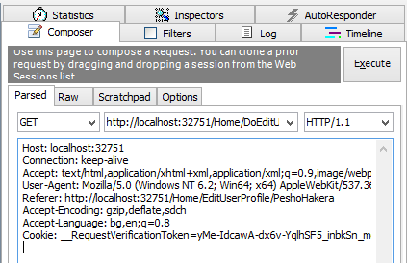
Parameter Tampering
Live Demo

Slide 35
Other Threats
Semantic URL attacks
URL Manipulation
Man in the Middle (MiTM)
Session Hijacking (easy if part of the URL)
Always use SSL when sending sensitive data
Insufficient Access Control
Error messages can reveal information
Denial of Service (DoS and DDos)
Brute force (use CAPTCHA!)
Phishing
Security flows in other software you are using
Social Engineering

Slide 36









ASP.NET MVC
https://softuni.bg/courses/asp-net-mvc/

Slide 37
License
This course (slides, examples, demos, videos, homework, etc.) is licensed under the "Creative Commons Attribution-NonCommercial-ShareAlike 4.0 International" license
Attribution: this work may contain portions from
"ASP.NET MVC" course by Telerik Academy under CC-BY-NC-SA license

Slide 38





Free Trainings @ Software University
Software University Foundation – softuni.org
Software University – High-Quality Education, Profession and Job for Software Developers
softuni.bg
Software University @ Facebook
facebook.com/SoftwareUniversity
Software University @ YouTube
youtube.com/SoftwareUniversity
Software University Forums – forum.softuni.bg

